Slide 1
Content Objective: Students will defend which future scenario they believe is most likely in relation to A.I. & Robotics.
Wednesday Dec. 4th
Unit 2 - Technical Basics of A.I.
Societal Impact of A.I. Creators
Potential Future Outcomes
Homework
No homework in the course. But I will make you think!

Slide 2

The “Gray Jedi Code” has a real name...

Slide 3
Day 1 - Social Impact
Why is it important to consider ethics and AI?
What is society? What do we view as being a good or bad society?
Who are the ones making the machines? Programming the machines? As we will learn later on, AI learns from us...are we always a good example?
See Hanson Robotics Website ----> Sophia
What might the ethical code of these people be as they create this robot?
Do you think they have similar or different ethics to us here in the classroom?

Slide 4
Scenario 1 - The Day the Yogurt Took Over
Scenario 2 - The Second Renaissance (warning: 9 min in - disturbing scene)
Scenario 3 - Sophia Talks About Her Plan
Let’s look at three different societal scenarios...categorize these as being either “evil,” “neutral,” or “good.” Come up with reasons why you feel these outcomes are good or bad and be ready to defend your thinking. Jot down significant moments that seem to go against (or with) your own ethical code.

Slide 5
Which Scenario do you believe is the most likely?
Get in a group of 2-3 and construct an argument for which one of these scenarios you believe is the most likely to play out in the future. Compare / contrast your ethical codes to help guide you. Write 2-3 paragraphs to defend your reasoning.
The goal of this course is to ensure that as the creators of Artificial Intelligence we have the power to determine which outcome we desire.
But if we can not come to an agreement on what we consider to be good or bad then AI might construct its own argument…is this dangerous?

Slide 6
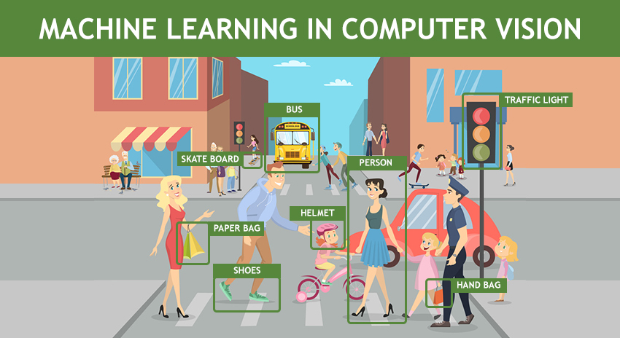

Tomorrow - Perception
What is Artificial Intelligence actually?
Computer Vision
How does a computer “see”?
Ethics of Perception

